Slide 1
Facial appearance
yasamansamsami@gmail.com
novingoftman@gmail.com

Slide 2
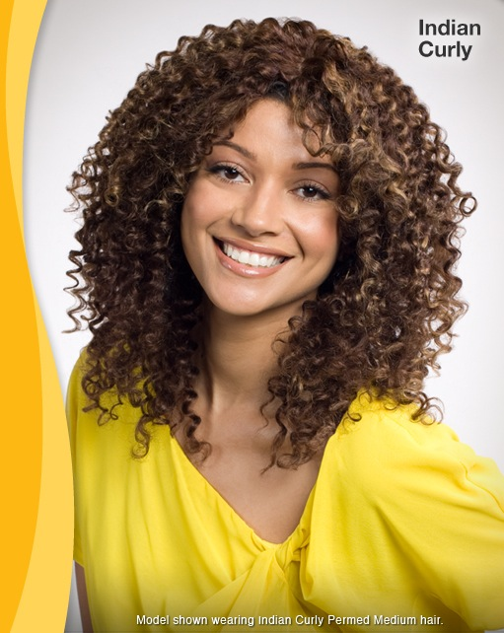
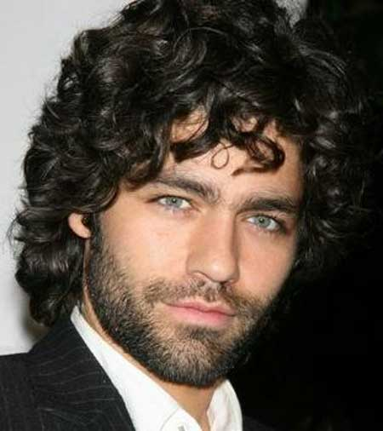
They’ve got curly hair.

Slide 3
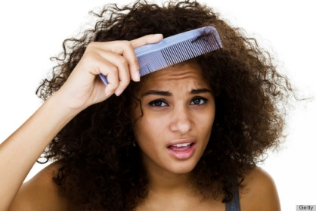
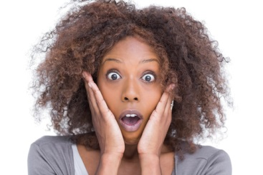
They’ve got frizzy hair.

Slide 4
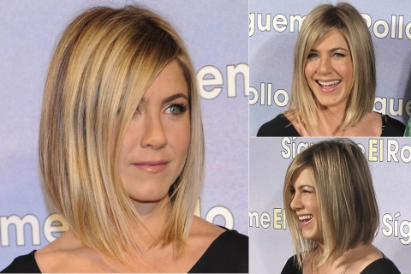
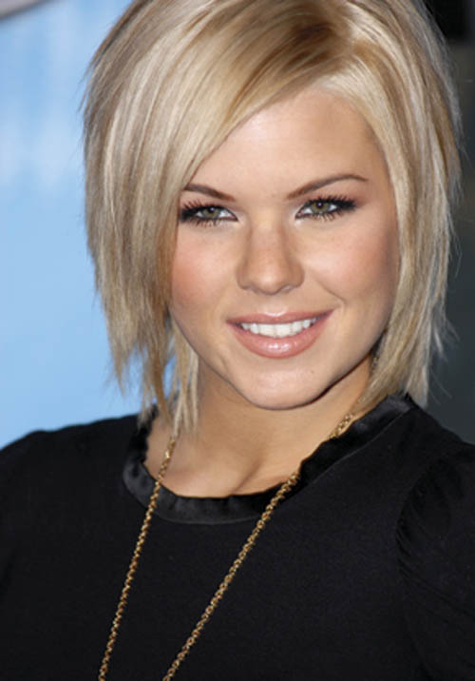
They’ve got a bob hairstyle.

Slide 5
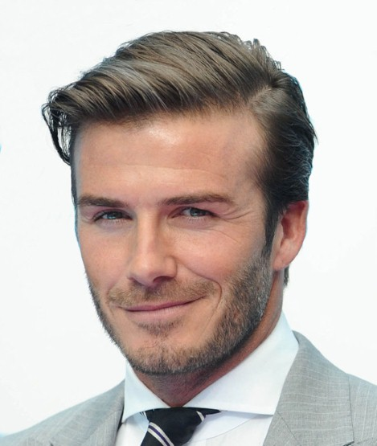
He has a side parting.
She has a centre parting.

Slide 6
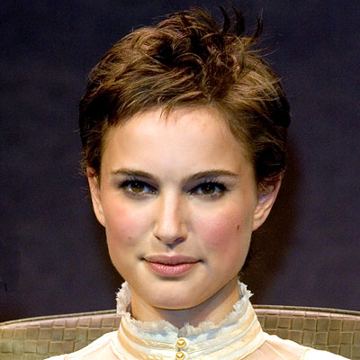
Natalie’s got cropped hair.
cropped=very short

Slide 7
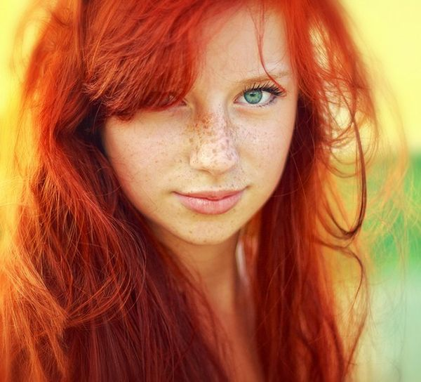
She’s got freckles round her nose.

Slide 8
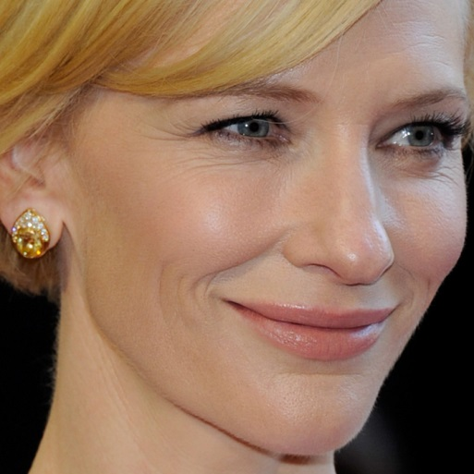
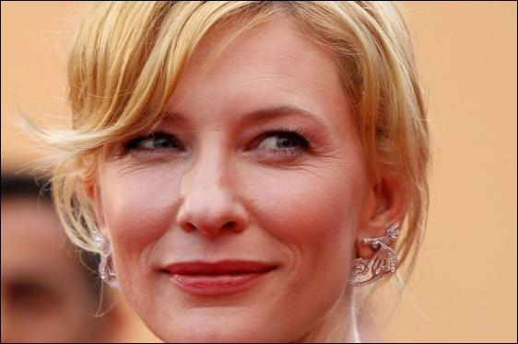
She’s got wrinkles round her eyes.

Slide 9
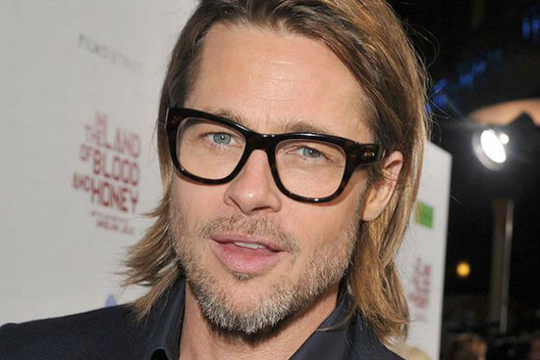
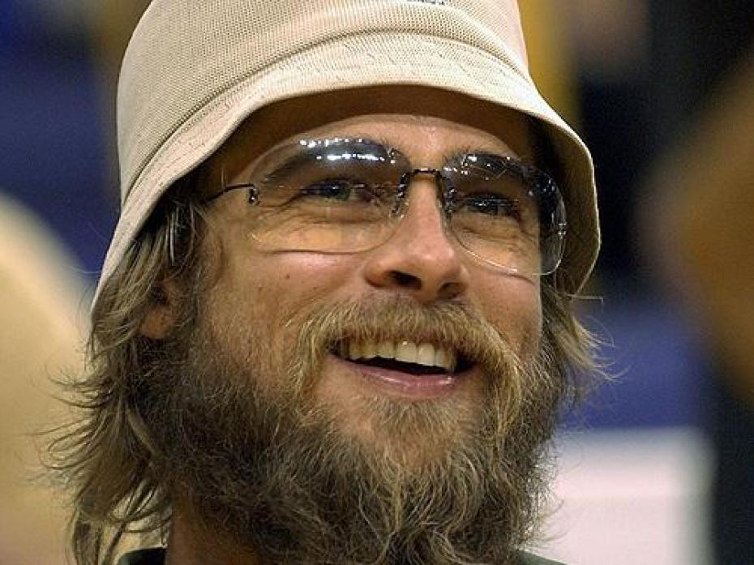
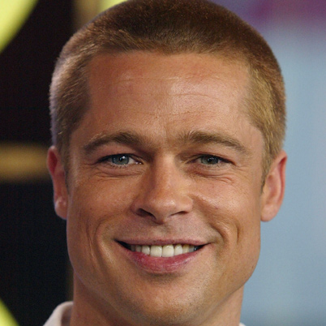
stubble
beard
clean-shaven
moustache

Slide 10
Slim: thin and attractive/ usually for girls and women Example: Helen is slim.
Skinny: really thin but not attractive. Example: a skinny child
Lean: thin and fit/ mostly for men Example: a lean man
Plump: a little fat and attractive/ more polite than fat Example: a plump little boy
Chubby: a little fat and nice/ usually for babies and children Example: a chubby baby
Lanky: tall with long and thin arms and legs/ usually for teenage boys Example: He’s very lanky.
Well-built: big and strong/ usually for men Example: He’s well-built.

Slide 11
Now, describe these people!

Slide 12
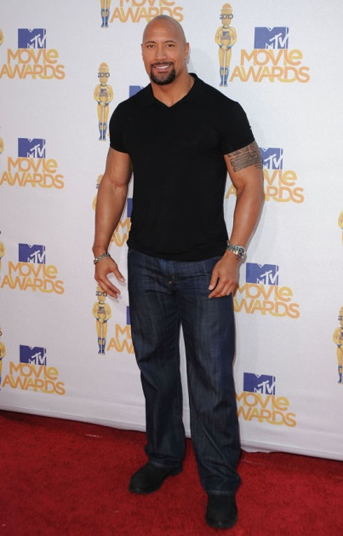
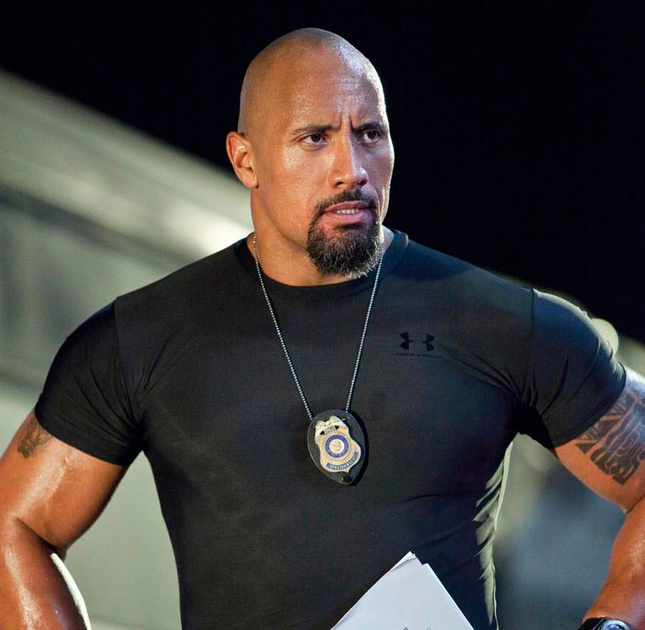

Slide 13
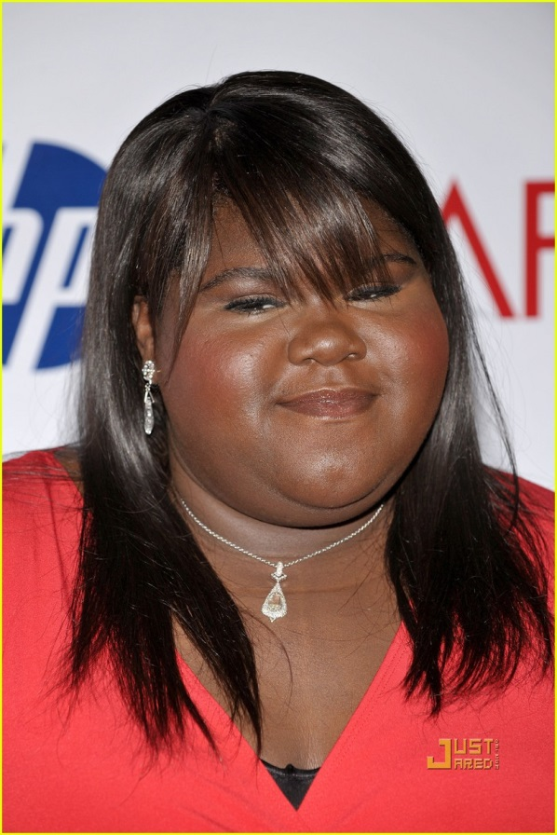
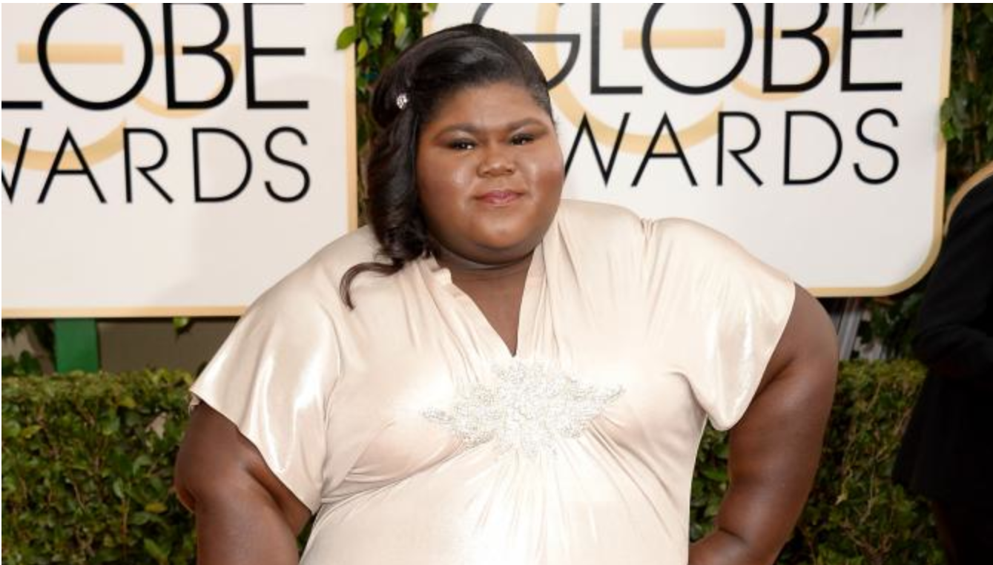

Slide 14
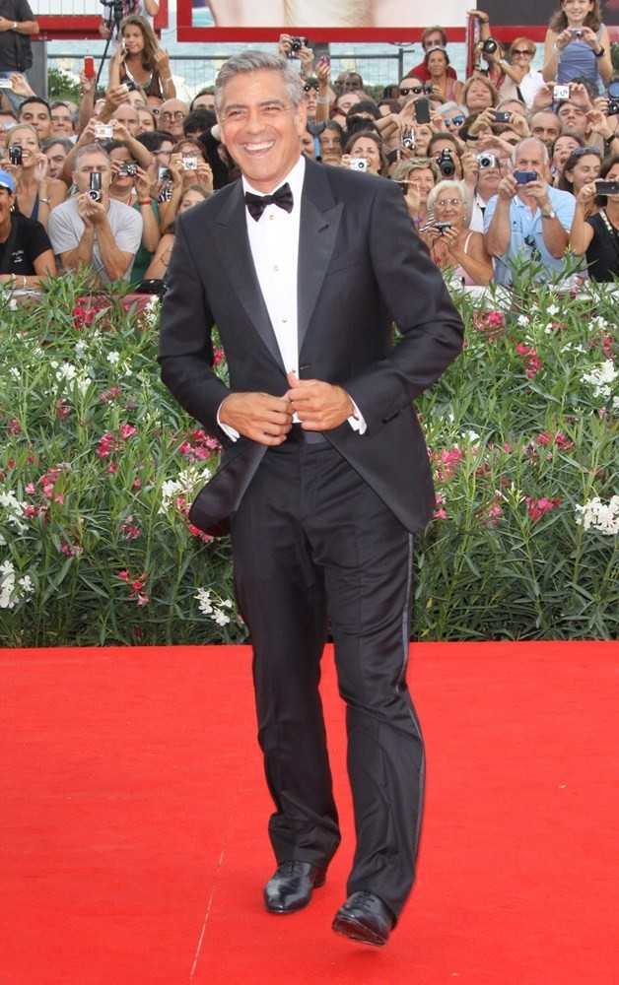
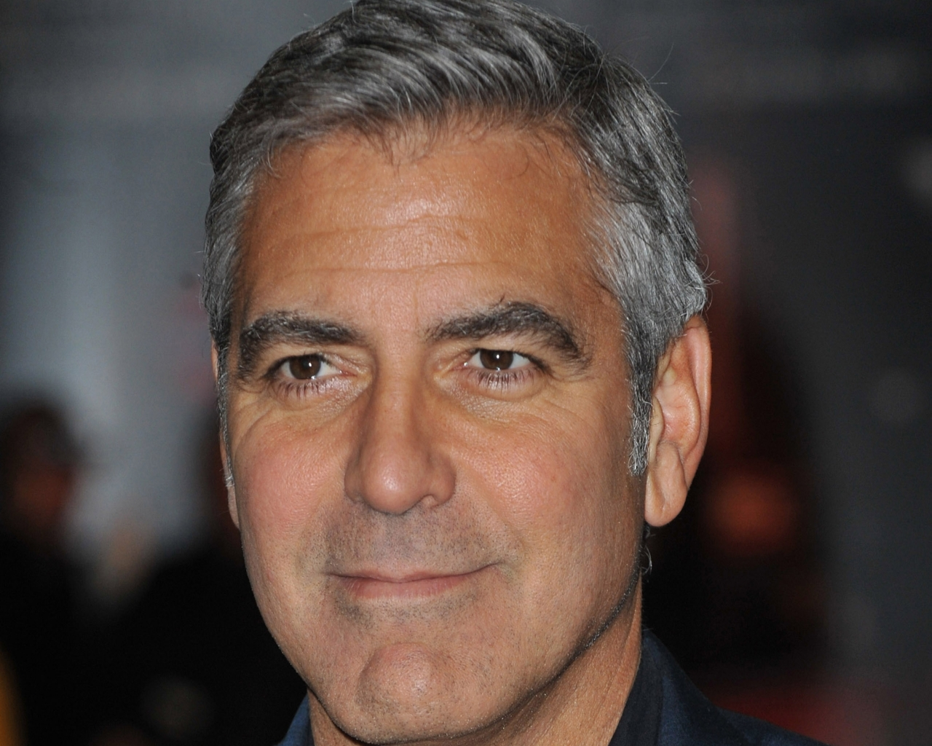

Slide 15
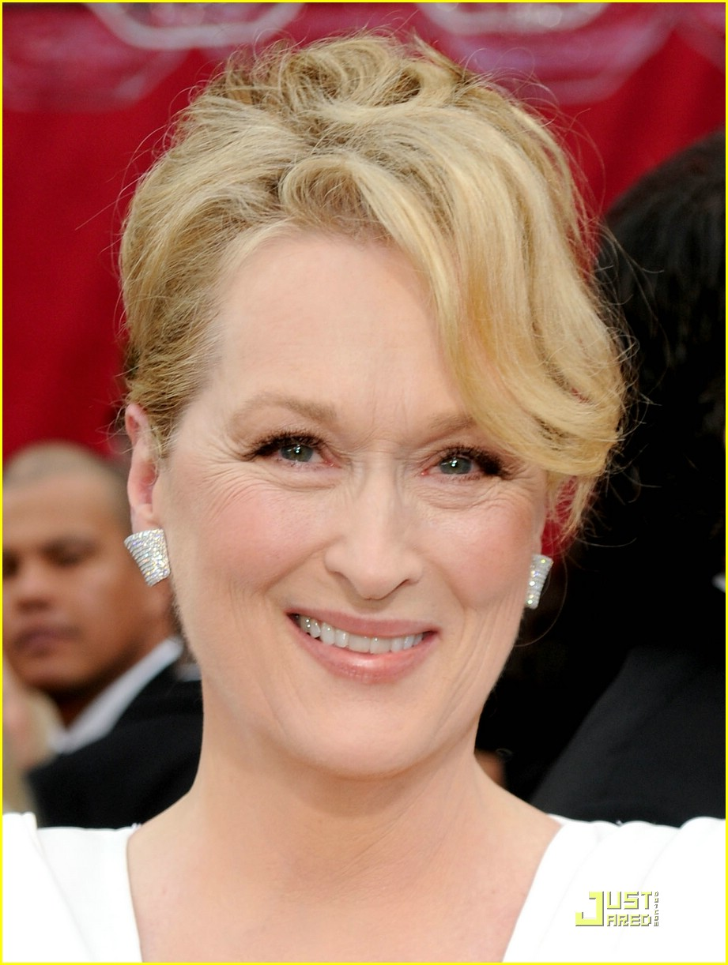
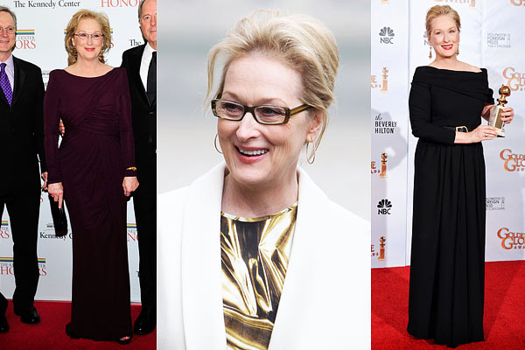

Slide 16
